Slide 1
Here are some blank sheets and Arrownotes to make your own songs. Download these resources and then compose by filling in the empty beats using the arrows provided or print off and use coloured pens or pencils.

Slide 2
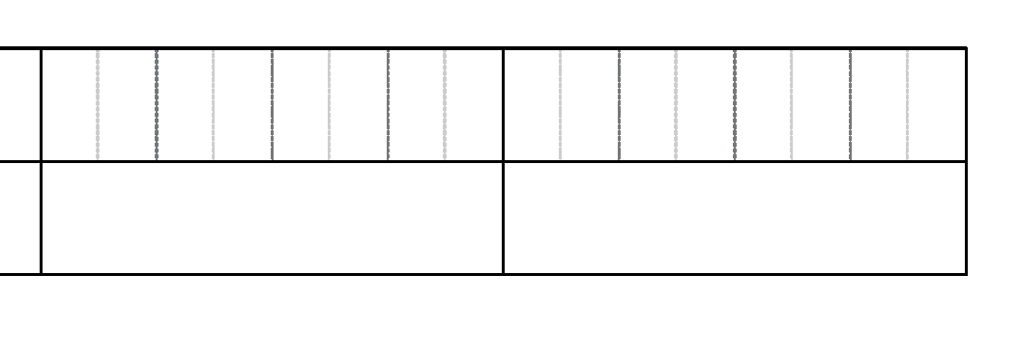
1
2
3
4
1
2
3
4
1
2
3
4
1
2
3
4

Slide 3
1
2
3
4
1
2
3
4
1
2
3
4
1
2
3
4

Slide 4
Arrows
For Notes
For Octave Changes
Accidentals

