Slide 1




Resources › Free taster › Ode to Joy
Teaching Portal
Portal preview
Ode to Joy
Student locks
Lock class
0 connected
End Live Lesson
Resources
Ode to Joy
Your first notes with
Swipe and Arrownotes
Play a familiar tune with a Hip Hop backing beat.
A short taste of the Digit Music teaching portal
Taster experience
Previous
1 / 12
Open Swipe App
Next

Slide 2



Resources › Free taster › Ode to Joy
Teaching Portal
Portal preview
Ode to Joy
Student locks
Lock class
0 connected
End Live Lesson
Resources
Play Ode to Joy
Make your first notes, then discover what comes next.
Choose how you’d like to play
iPhone or iPad
Play in your browser
Scan or open the app link.
No installation needed.
Open Digit Swipe
Open web app
A short taste of the Digit Music platform
Taster experience
Previous
2 / 12
Open Swipe App
Next

Slide 3
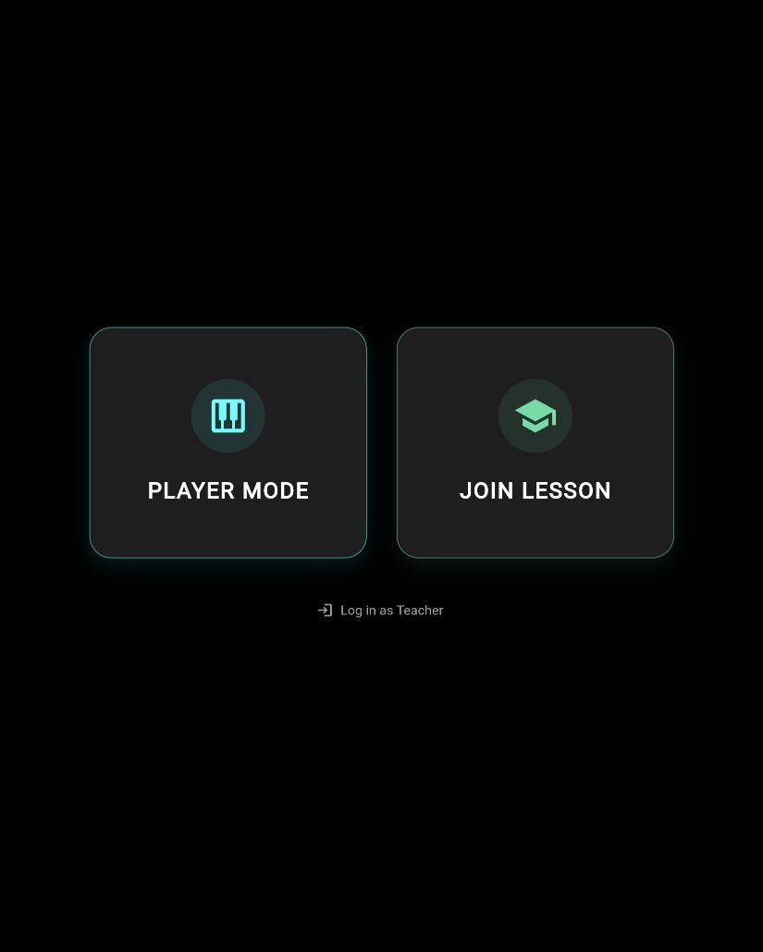
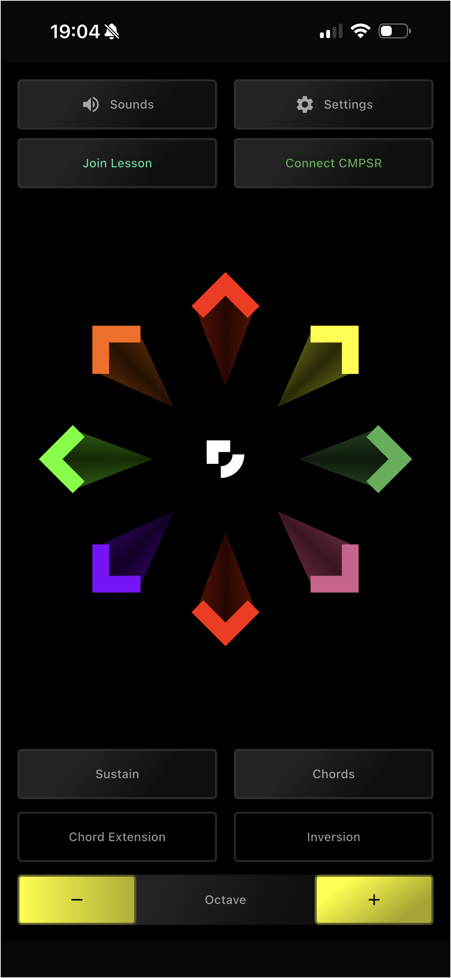
Resources › Free taster › Ode to Joy
Teaching Portal
Portal preview
Ode to Joy
Student locks
Lock class
0 connected
End Live Lesson
Resources
Your instrument
1 Choose Player Mode
2 Open Sounds
Choose Harp.
In Settings: Tap mode · C major.
Keep Chords and Sustain off.
Tap an arrow, then lift your finger.
Taster experience
Previous
3 / 12
Open Swipe App
Next

Slide 4
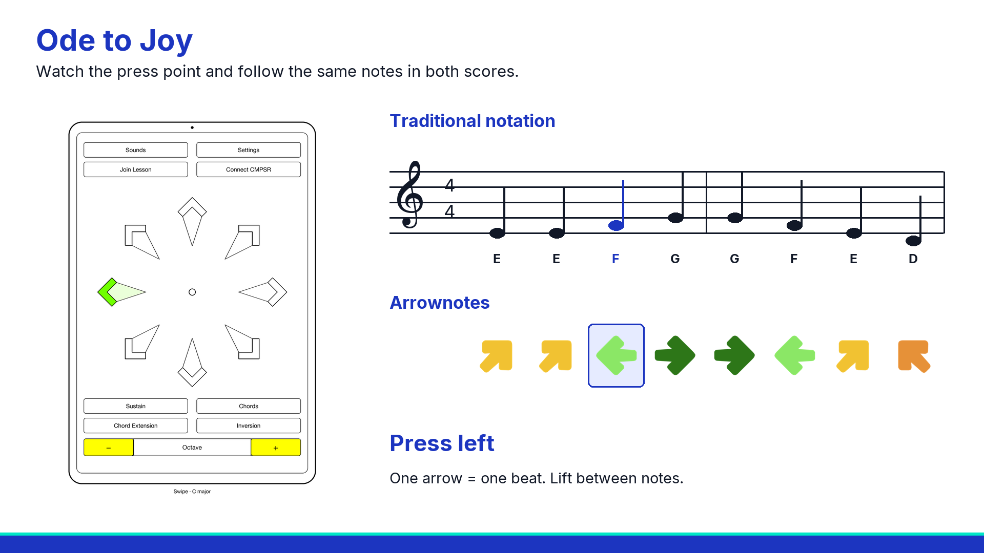
Resources › Free taster › Ode to Joy
Teaching Portal
Portal preview
Ode to Joy
Student locks
Lock class
0 connected
End Live Lesson
Resources
One tune, three ways to follow
Click the video to watch. Replay whenever you need.
Taster experience
Previous
4 / 12
Open Swipe App
Next

Slide 5

Resources › Free taster › Ode to Joy
Teaching Portal
Portal preview
Ode to Joy
Student locks
Lock class
0 connected
End Live Lesson
Resources
Your first four notes
Listen once. Then copy these four presses.
Hear the first four notes
Up-right twice. Left. Right.
One arrow is one beat. Lift your finger between notes.
Taster experience
Previous
5 / 12
Open Swipe App
Next

Slide 6

Resources › Free taster › Ode to Joy
Teaching Portal
Portal preview
Ode to Joy
Student locks
Lock class
0 connected
End Live Lesson
Resources
The next four notes
The tune comes back down.
Hear the next four notes
Right. Left. Up-right. Up-left.
Repeat a short part until it feels comfortable.
Taster experience
Previous
6 / 12
Open Swipe App
Next

Slide 7
Resources › Free taster › Ode to Joy
Teaching Portal
Portal preview
Ode to Joy
Student locks
Lock class
0 connected
End Live Lesson
Resources
Your opening with a beat
Listen for four count-in beats, then play from the first arrow.
Hear the tune with the beat
Play with the Hip Hop beat
You’ve made a start. Try it again, or explore what comes next.
Taster experience
Previous
7 / 12
Open Swipe App
Next

Slide 8
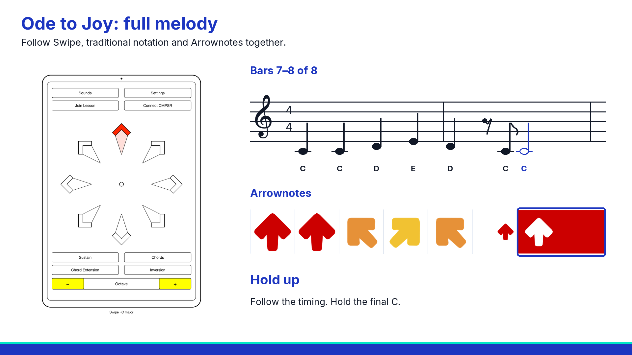
Resources › Free taster › Ode to Joy
Teaching Portal
Portal preview
Ode to Joy
Student locks
Lock class
0 connected
End Live Lesson
Resources
The full melody with the beat
Watch both rows, then try the full melody on the next slide.
Taster experience
Previous
8 / 12
Open Swipe App
Next

Slide 9
Resources › Free taster › Ode to Joy
Teaching Portal
Portal preview
Ode to Joy
Student locks
Lock class
0 connected
End Live Lesson
Resources
Your turn: the full melody
Four count-in beats. Play the top row, then the bottom row.
1
2
Play the full Hip Hop backing
C major 84 BPM
Follow the gaps. Hold the final C until its coloured box ends.
Taster experience
Previous
9 / 12
Open Swipe App
Next

Slide 10
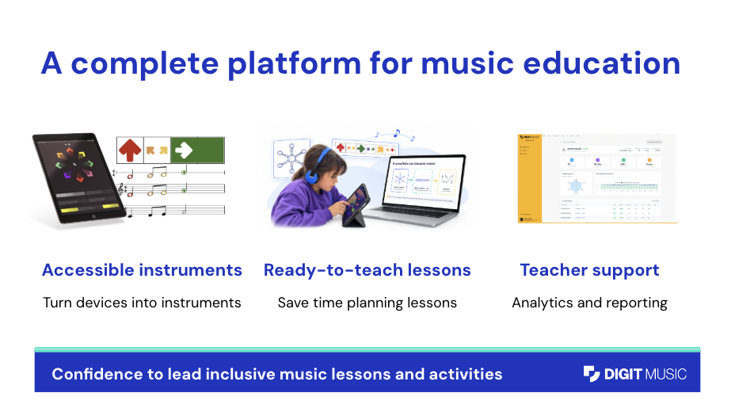
Resources › Free taster › Ode to Joy
Teaching Portal
Portal preview
Ode to Joy
Student locks
Lock class
0 connected
End Live Lesson
Resources
A platform that supports your teaching
Accessible instruments
Ready-to-teach lessons
Support to get started
Turn devices into instruments.
Guidance and musical resources together.
Onboarding and practical help for your school.
Confidence to lead inclusive music lessons and activities
Taster experience
Previous
10 / 12
Open Swipe App
Next

Slide 11
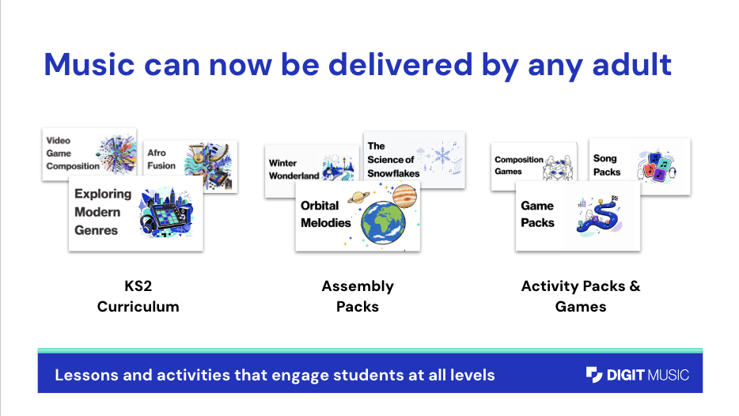
Resources › Free taster › Ode to Joy
Teaching Portal
Portal preview
Ode to Joy
Student locks
Lock class
0 connected
End Live Lesson
Resources
There’s more to explore in the portal
KS2 curriculum
Assembly packs
Activities and games
Explore genres and make music.
Bring a theme to life through music.
Find a new way to get learners playing.
Lessons and activities for different starting points
Taster experience
Previous
11 / 12
Open Swipe App
Next

Slide 12
Resources › Free taster › Ode to Joy
Teaching Portal
Portal preview
Ode to Joy
Student locks
Lock class
0 connected
End Live Lesson
Resources
Six months to try it with your school
£295 + VAT
Six months of full-platform access for your whole school.
Supported onboarding and practical implementation guidance.
Explore the school offer
Ask us about a demo
Six months from purchase.
Whole-school access, supported from the start
Taster experience
Previous
12 / 12
Open Swipe App
Next

